Slide 1




Radio
Blob
AKGigi
CMLS homework #3
Riccardo Alfieri
Riccardo Iaccarino
Manuele Montrasio
Silvio Sgotto
Francesco Veronesi

Slide 2
Introduction
We designed a Computer Music System (CMS) with interaction design principles by means of Arduino, SuperCollider and Processing.
The CMS we realized is a weather station that processes and transforms climate data into audio signals.
Our idea was to create a system that generates ambient generative music influenced by the weather conditions and, in some way, reflects them.

Slide 3
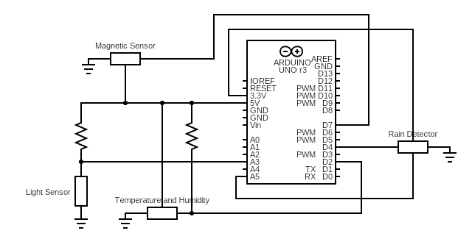
Arduino
Map physical phenomena into numerical parameters
Components
Temperature and Humidity Sensor
Rain Detector
Light Sensor
Magnetic Sensor (Anemometer)

Slide 4
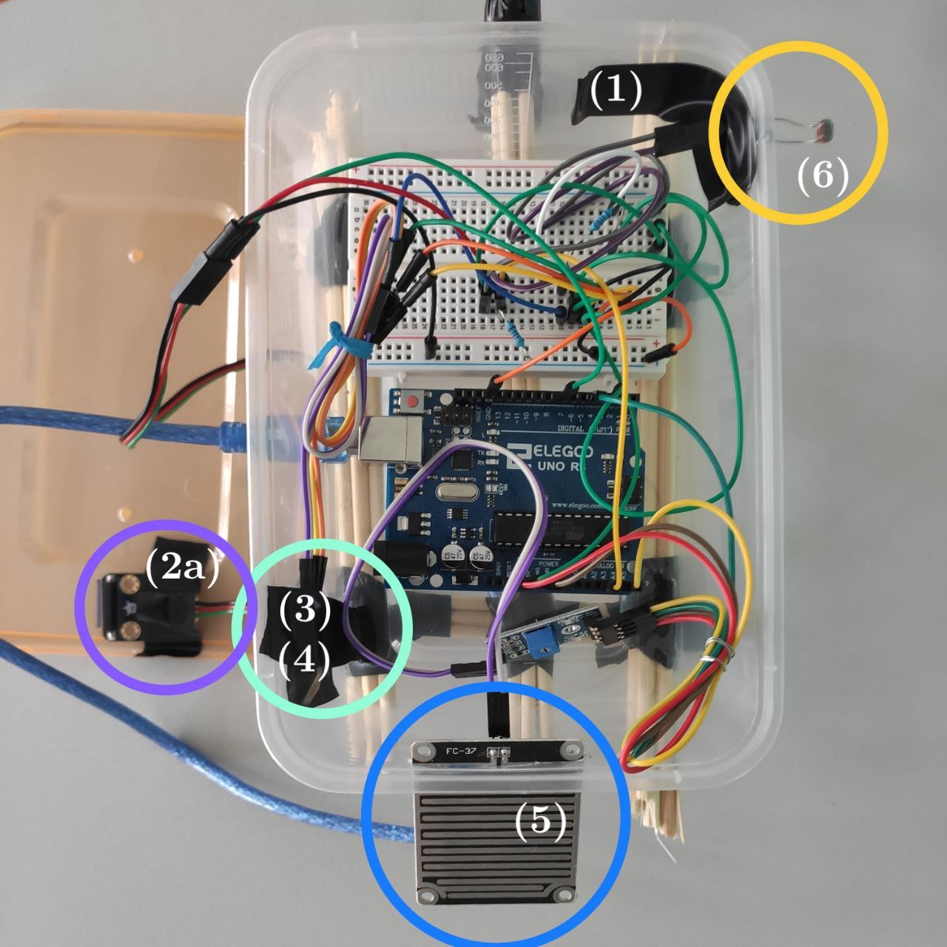
Arduino
Board and station configuration
Every single component can be somehow treated as an isolated circuit with respect to the others.
Rain and Magnetic sensors can be used in a “plug and play” fashion, hence we can just connect them to the 5V line, the GND (ground) and to their respective input pins.
For the other two components we need to add a resistor in series to the concerned pin of the sensor, which will behave as a variable resistor.

Slide 5
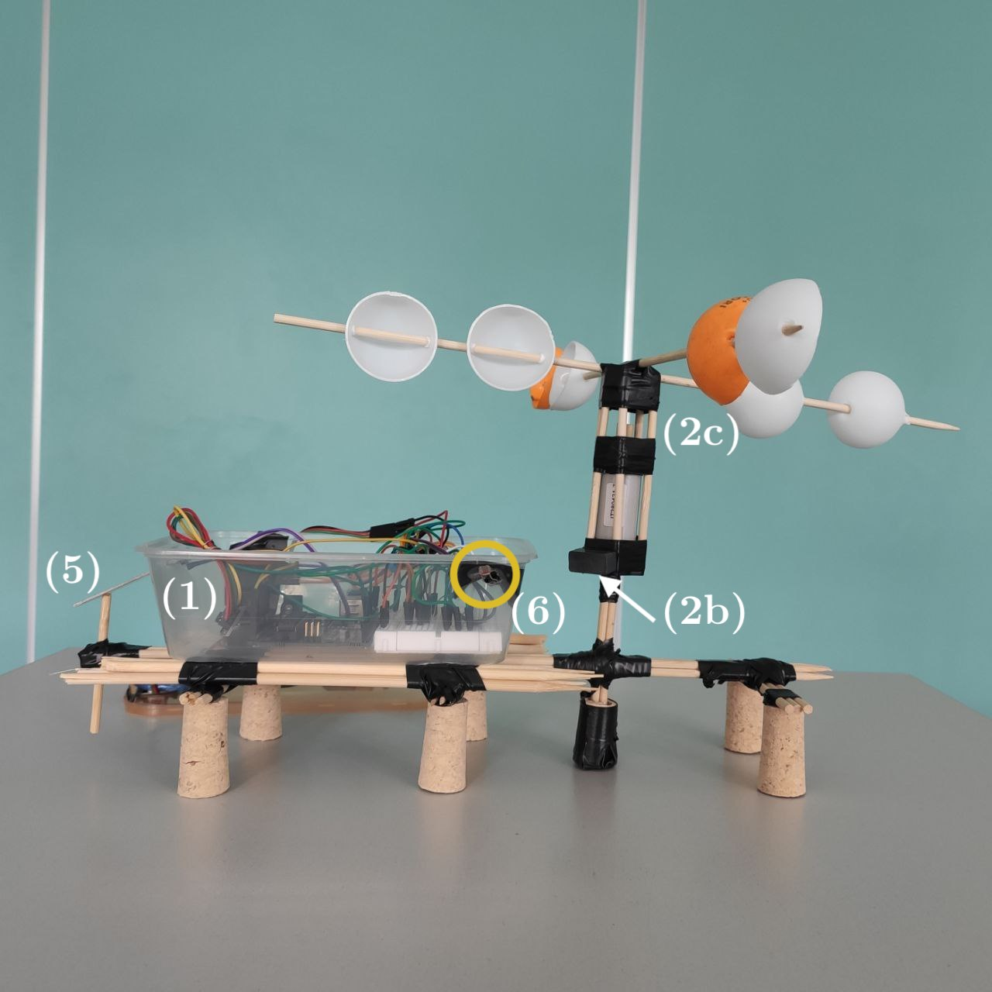
Arduino
Board and station configuration
Every single component can be somehow treated as an isolated circuit with respect to the others.
Rain and Magnetic sensors can be used in a “plug and play” fashion, hence we can just connect them to the 5V line, the GND (ground) and to their respective input pins.
For the other two components we need to add a resistor in series to the concerned pin of the sensor, which will behave as a variable resistor.

Slide 6
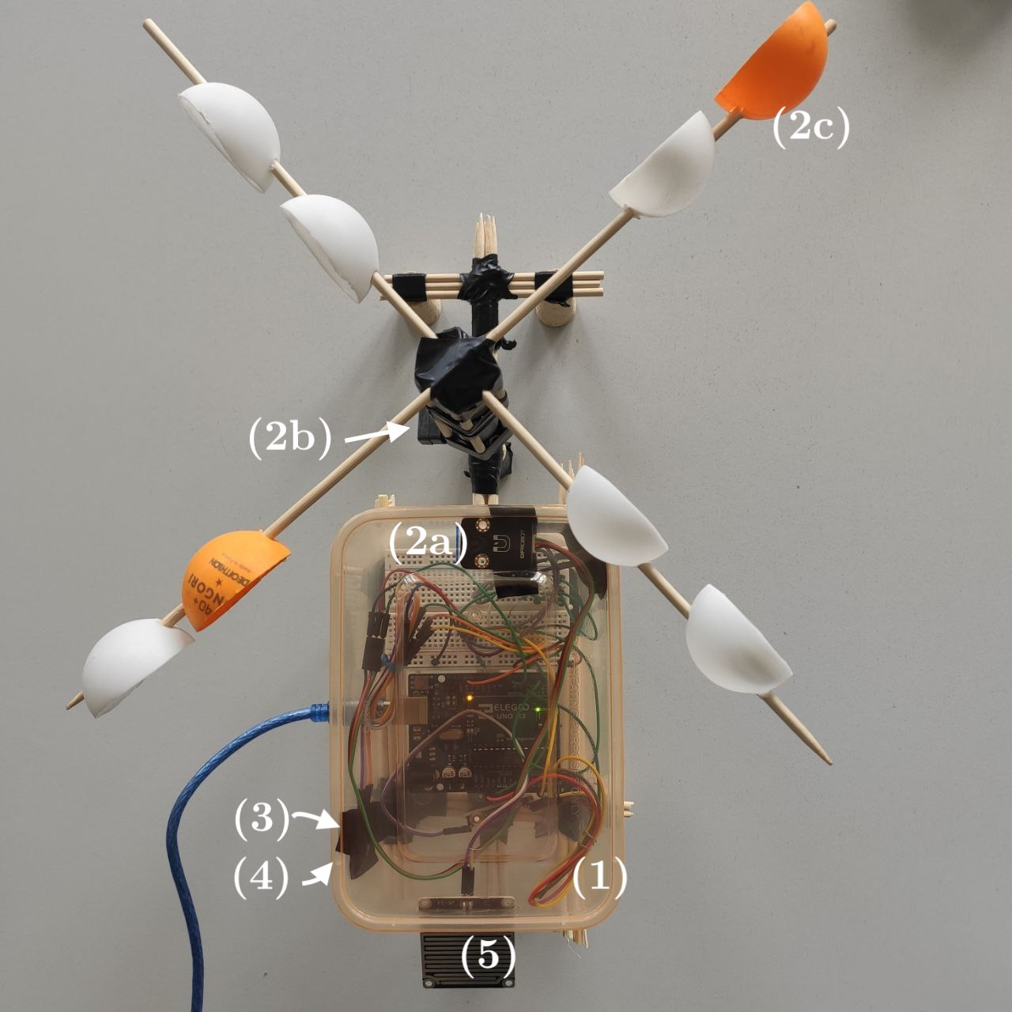
Arduino
Board and station configuration
Every single component can be somehow treated as an isolated circuit with respect to the others.
Rain and Magnetic sensors can be used in a “plug and play” fashion, hence we can just connect them to the 5V line, the GND (ground) and to their respective input pins.
For the other two components we need to add a resistor in series to the concerned pin of the sensor, which will behave as a variable resistor.

Slide 7
SuperCollider
SuperCollider was used for the creation of a musical loop that is able to change according to the values that receives from the sensors of Arduino.
Whole song is created by compiling simultaneously a series of Routine, one for each instrument.
The other useful SuperCollider tool we used is the Pbind class, that allows to easily control a series of events, such as a series of notes.
Main sections of the loop: the melodic, the harmonic and the rhythmic part.

Slide 8
SuperCollider
Changing parameters
Wind → BPM
Proportionally, from 60 (with no wind) to 100 (with maximum wind)
Temperature → LPF/HPF
Low temperature → HPF, High temperature → LPF
Humidity → Reverb
If the detected value is higher than 45%.
Brightness → Instruments
As the environmental brightness decreases, the melodic instruments are turned off one by one.
Mood → Scale:
Mood is a variable that is calculated as a weighted average of all the data we get from the sensors, processed in a certain way. The mood value corresponds to a change of the scale through the class Scale.

Slide 9
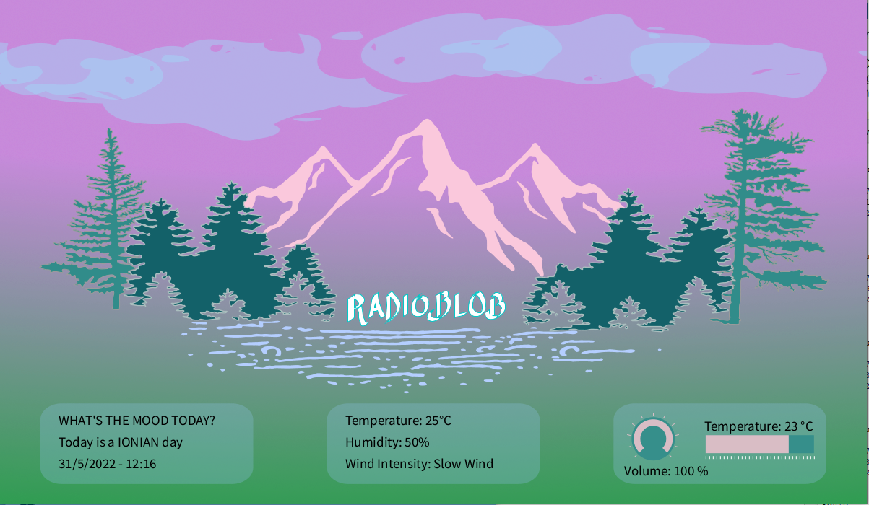
Processing

Slide 10
Processing
In the GUI we decided to display every kind of event detected by our Arduino station.
Day and night:
Two radial gradients that act as background themes (.png), switching at a given time.
Wind:
Implemented as the oscillating movement of the trees (.svg).

Slide 11
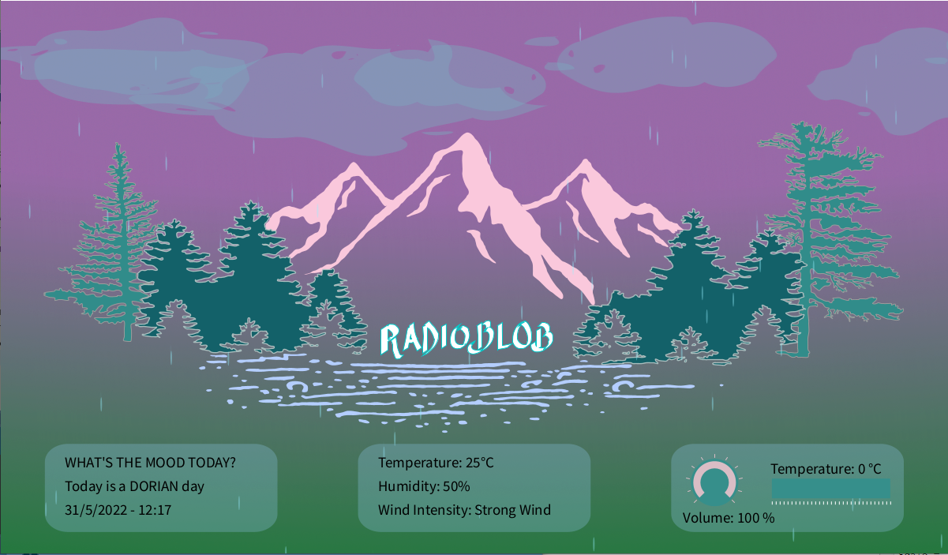
Processing

Slide 12
Processing
Clouds:
Moving elements in the sky (.png) that reflect the amount of light sensed. They loop in the window until the light raises over a certain value. The only limitation is the impossibility to catch any quantity that could give us a feedback on the presence of clouds by night.
Rain:
Drops falling accordingly to the weather condition. For this element we relied simply on the tools offered by Processing, creating oblong ellipses that move over time.

Slide 13
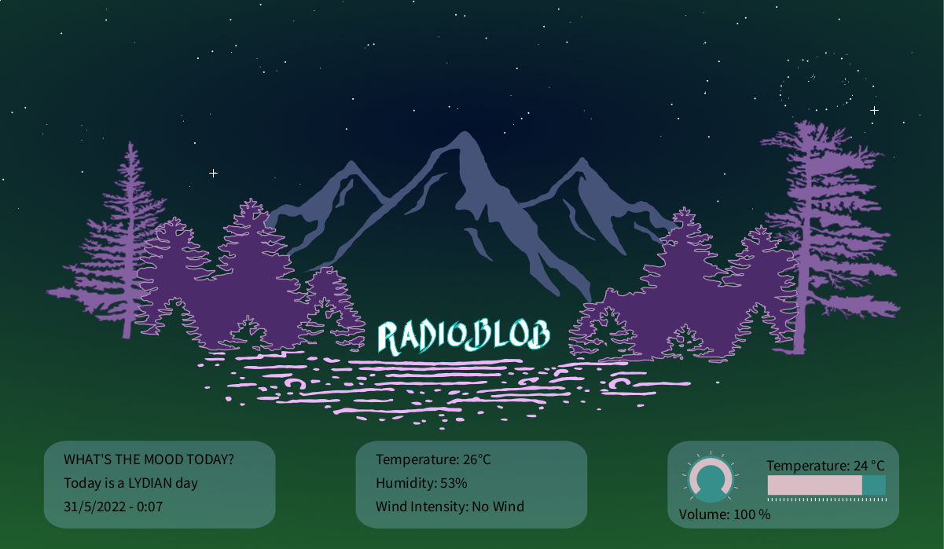
Processing

Slide 14
Processing
Stars:
Randomly positioned during the setup phase, these little circular ellipses can shine thanks to the implementation of simple line elements that appear occasionally.

Slide 15

Processing
Additional features
Temperature slider

Slide 16
Processing
Additional features
Volume knob

Slide 17
Processing
Additional features
Real time weather values

Slide 18
Processing
Additional features
Date, hour and mood value

Slide 19
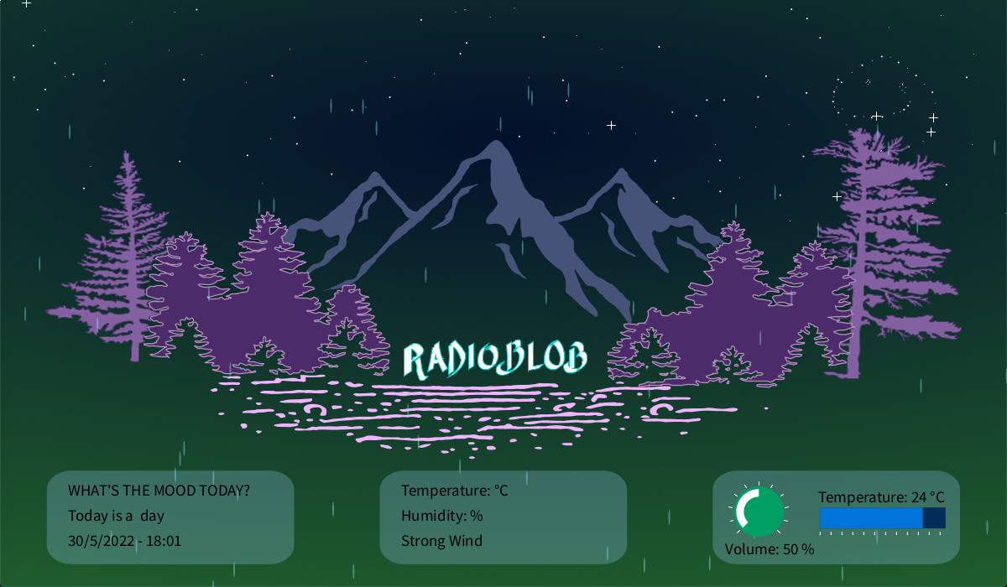
Conclusions
Pros:
The connection between all the different types of software and the hardware has been completed successfully.
Compact structure.
We are satisfied with the fact that the mood of the music is connected quite well to the weather.
The GUI is responsive as we intended.

Slide 20
Conclusions
Cons:
Fragility of the structure.
The anemometer is rudimentary and the values we get from it aren’t accurate enough to calculate the speed of the wind.
Music could be perceived as repetitive as it is composed of a finite number of musical and rhythmic patterns that follow one another randomly.

